Slide 1


Software Engineering:
A Perspective for 2003
Linda Shafer
Director, Software Quality Institute (SQI)
The University of Texas at Austin
www.utexas.edu
lshafer@mail.utexas.edu
Don Shafer
Chief Technology Officer, Athens Group, Inc.
www.athensgroup.com
donshafer@athensgroup.com

Slide 2
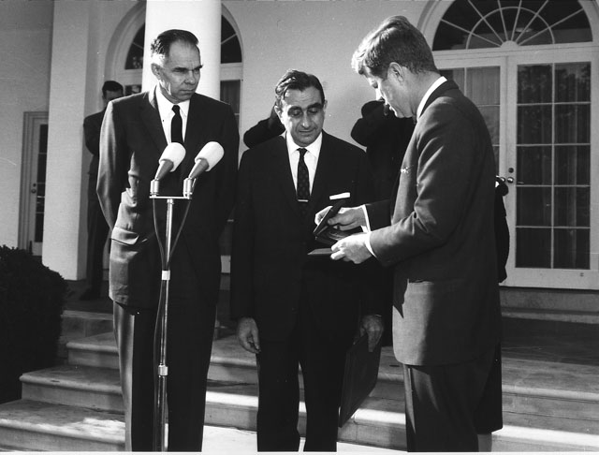

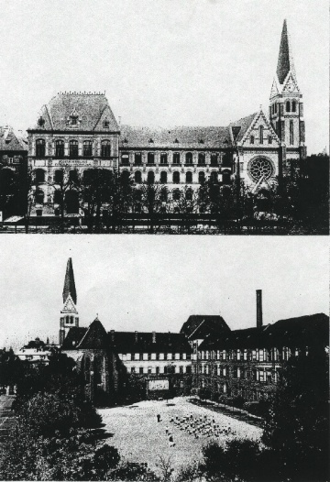
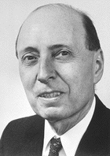
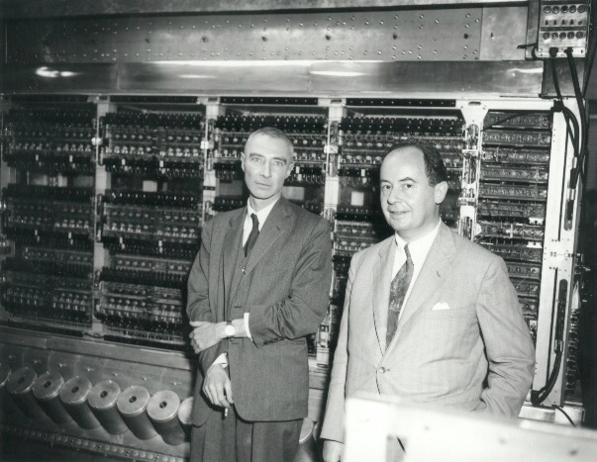
Seminar Dedication
Enrico Fermi referred to these brilliant Hungarian scientists as “the Martians,” based on speculation that a spaceship from Mars dropped them all off in Budapest in the early 1900’s.
Notes:
http://carnegieinstitution.org/PRManhattan3-20-02FIN.htm
the Hungarian émigrés who were instrumental in the Manhattan Project (e.g., Leo Szilard, Edward Teller, János Von Neumann, and Jenó Pál Wigner. Eniro Fermi referred to these brilliant Hungarian scientists as “the Martians,” based on speculation that a spaceship from Mars that dropped them all off in Budapest in the early 1900’s
http://www.dannen.com/szilard.html Szilard's ideas included the linear accelerator, cyclotron, electron microscope, and nuclear chain reaction. Equally important was his insistence that scientists accept moral responsibility for the consequences of their work.
In his classic 1929 paper on Maxwell's Demon, Szilard identified the unit or "bit" of information. The World Wide Web that you now travel, and the computers that make it possible, show the importance of his long-unappreciated idea.
http://www-hoover.stanford.edu/bios/teller.html Edward Teller is a senior research fellow at the Hoover Institution, where he specializes in international and national policies concerning defense and energy.
Teller is most widely known for his significant contributions to the first demonstration of thermonuclear energy; in addition he has added to the knowledge of quantum theory, molecular physics, and astrophysics. He served as a member of the General Advisory Committee of the U.S. Atomic Energy Commission from 1956 to 1958 and was chairman of the first Nuclear Reaction Safeguard Committee.
Szilard bio - http://www.dannen.com/chronbio.html
Wigner bio - http://www.nobel.se/physics/laureates/1963/wigner-bio.html
teller info - http://www.llnl.gov/PAO/photos/Tellercap.html
Von Neumann info - http://www.physics.umd.edu/robot/neumann.html
VOn Neumann & Wigner's high school in Budapest - http://www.physics.umd.edu/robot/evangel.html

Slide 3
Software Engineering Seminar
Many professionals feel that the Waterfall Model is old fashioned or simplistic, having long ago outlived its usefulness – the very name seems wrong, since water cannot “fall” uphill to accommodate the backward arrows. All sorts of new models have been depicted to better show how the “real world” works, or how software can be developed faster, or how customers can become more engaged in the process to improve functionality. The Spiral Model, the Evolutionary Rapid Prototyping Model, the “V”-Shaped Model and others have emerged to solve one issue or another. Today, most practitioners might agree that there are so many different types of projects, a one size SLC cannot possible fit all. The modern viewpoint is that unique projects require unique models, or combinations of models to succeed. We will discuss the choice of appropriate SLC models, or modified versions of SLC models, the real baseline for beginning software engineering. We will describe several of the more modern SLC’s (e.g. eXtreme, RUP), and how a project manager can decide which one to use. We will also explain what the various bodies of knowledge (e.g. PMBOK, SWEBOK) map to our life cycles.

Slide 4
Presentation Description
The key to managing a software development project is having a high level road map to identify where you are on the project. The life cycle model you adopt for your development project is this roadmap. Using IEEE 1074, we will walk through a "standard" development life cycle and all the supporting processes required; e.g. configuration management, documentation, project management, software quality assurance. Using this as the baseline we'll construct a first pass WBS for the life cycle.
The next steps will be to customize the baseline life cycle for two different types of development: evolutionary rapid prototyping and commercial-of-the-shelf package selection.
To wrap up, some metrics on life cycles for web-based application delivery.

Slide 5
NOT the Model you want!
Inputs
Code & Test
Outputs
Do Until Done

Slide 6
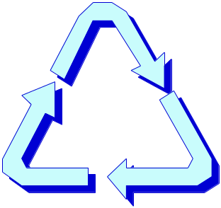
Product Development
Tools
Technology
Products
Methods

Slide 7
A Quick Level Set
Technology
  Application of scientific knowledge in industry or business
Tool
  An implement or machine used to do work or perform a task.
Method
  A manner, means or process for accomplishing something.

Slide 8
What’s in each segment?
Internet
Intranet
Extranet
Object-Oriented
VoIP
Oracle
Copernic
Java
UML
XML
Tools
Technology
Products
Methods
Software Engineering Project Management

Slide 9
How do products happen?
Products
Products
Tools
Technology
Methods
Technology
Tools
Products
Methods
Ideas

Slide 10
Project Management Mitigates the Front End Risks
Plan
Concept
Definition
Improve
Risk Reduction
Research
Planning
Candidate
Architecture
Identification
Management Plan
Risk Analysis
Databases
Quality
Market and
System
Requirements
ROI Analysis
Specifications
Estimating
Needs Assessment
Adapt
Project Plans
Observe
Configuration Management
Training
Analyze

Slide 11
Defining Your Life Cycle Model
Become familiar with the various models
Review, analyze the type of work: development, enhancement, maintenance, etc.
Review project criteria
Identify a minimum set of phases
Identify phase activities
Establish a minimum set of deliverables
Define templates and content guides for deliverables
Evaluate progress and effectiveness of the life cycle framework
Implement improvements
Notes:
Models should be customized to meet the specific needs of the project for which they have been selected. The model should reflect the actual phases and activities expected to be performed on the project. This type of customization will assist in tracking the project to the model.
Major phases may be: Feasibility/Scoping, Planning, Analysis & Design, Execution, Delivery, Post Delivery
Another view is: Planning, Specification, Development, Post Project Analysis
Once the customization of the model is completed, the model becomes more meaningful to the project team and the user community. It can be used as a reference point during: status reporting sessions, demonstrations, risk assessment sessions, delivery of the final product.
What if during the course of the project, something changes which causes the team to think a different model may be more appropriate? Can the model be changed during the execution of the project? The answer is yes, it can be changed, but should be done with careful consideration to the impacts of the project. Ultimately, it is better to change the model than to attempt to use one that is ill-suited to meet the needs of the project.

Slide 12
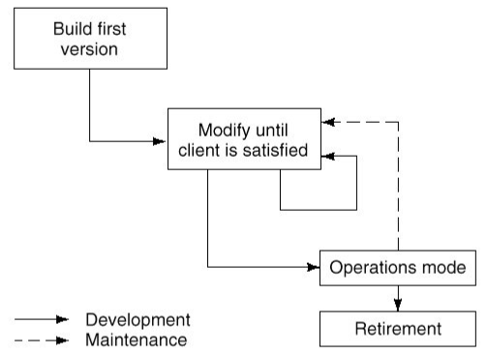
Build and Fix

Slide 13
Build and Fix – Good and Bad
Pros: | Cons:
Works for projects generating less than 200 LOC | One step beyond code and test
 | Does not scale with large projects
 | No specifications
 | Not a life cycle model

Slide 14
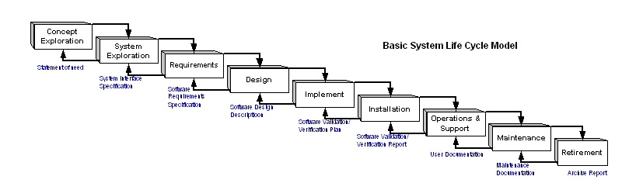
Basic 1074 Life Cycle

Slide 15
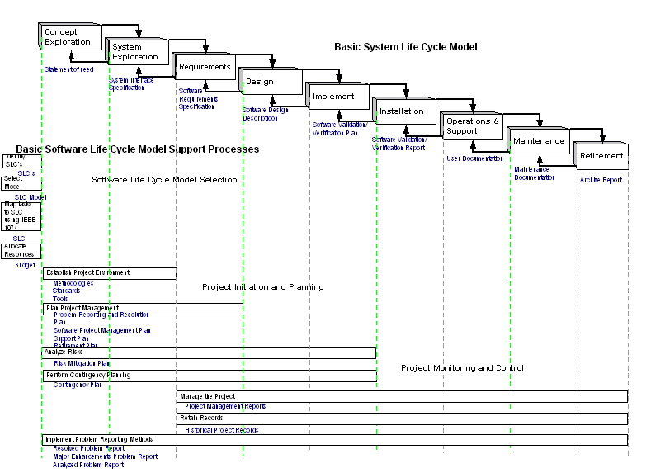
Full 1074 Life Cycle (1)

Slide 16
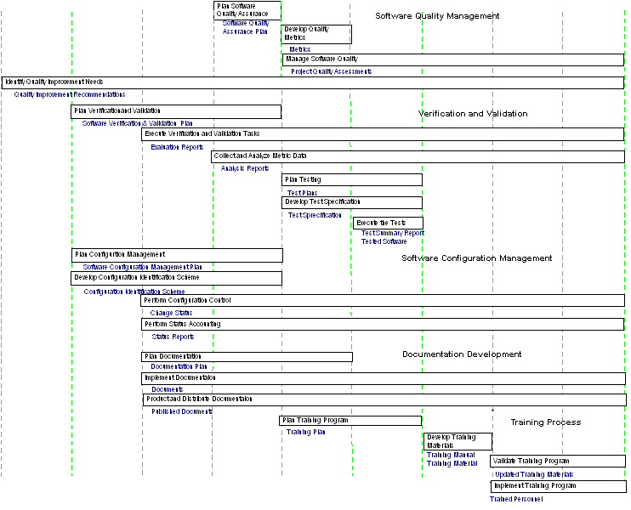
Full 1074 Life Cycle (2)

Slide 17
Full 1074 Life Cycle – Good and Bad
Pros: | Cons:
THE starting point for defining you life cycle | Too much process
Contains all the life cycle supports you would need | Contains more than you may reasonably use
Is a process for defining your life cycle | Is not in and of itself a life cycle to implement

Slide 18
Waterfall Model
Planning
Analysis
Design
Build
Test
Deploy

Slide 19
Waterfall Model – Good and Bad
Pros: | Cons:
Easiest to understand | Does not model the real world
Easiest to instrument | Too much documentation
Enforced discipline
Document and deliverable driven

Slide 20
Waterfall with Prototyping
Process Steps
Process Gates
Prototypes
REQUIREMENTS DEFINITION
PROTOTYPE
1
REVIEW
HIGH LEVEL DESIGN
PROTOTYPE
2
REVIEW
DETAIL DESIGN
PROTOTYPE
3
REVIEW
SYSTEM CONSTRUCTION
REVIEW
VERIFICATION & VALIDATION
REVIEW
SYSTEM DELIVERY
POST
IMPLEMENTATION
REVIEW
REVIEW
Project Management Support Processes
Risk Reduction Training Planning Configuration Management Estimating Metrics Quality Assurance

Slide 21
Prototyping Model - Pros and Cons
Pros: | Cons:
Easiest to understand | Not stopping the prototyping
Easiest to instrument | Prototyping becomes early code hacking
Real world modeling
Recursion among process steps
Document and deliverable driven

Slide 22
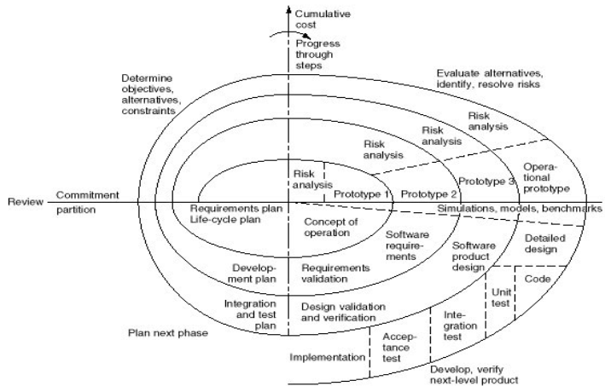
Spiral Model

Slide 23
Spiral Good and Bad
Pros: | Cons:
Emphasizes risk reduction | Internal development of large systems
Supports reuse | High overhead costs
Maintenance and development mesh | Requires a mature organization
Easy look at product with prototypes | Risk and prototyping tools a must
Risk focused testing

Slide 24
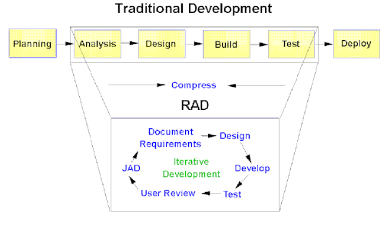
Rapid Application Development

Slide 25
RAD – Good/Bad
Pros: | Cons:
Lots of user interaction | Users intimately involved
Early proof of concept | Needs maturity of tools and process
Incremental building | Increased overhead if too many prototypes
 | Tight delivery control
 | Poorly set expectations

Slide 26
Selecting a Life Cycle Model - Project Characteristic Category Matrix Requirements
Requirements
Waterfall
Prototype
Spiral
RAD
Are the requirements easily defined and/or well known?
Yes
No
No
Yes
Can the requirements be defined early in the cycle?
Yes
No
No
Yes
Will the requirements change often in the cycle?
No
Yes
Yes
No
Is there a need to demonstrate the requirements to achieve definition?
No
Yes
Yes
Yes
Is a proof of concept required to demonstrate capability?
No
Yes
Yes
Yes
Notes:
Requirements
The requirements category consists of questions related to those things which have been requested by the user for the project. They are sometimes termed as functions or features of the system which will be provided by the project. Consider these questions:
Are the requirements easily defined and well known?
Can the requirements be defined early in the cycle?
Will the requirements change often in the cycle?
Is there a need to demonstrate the requirements to achieve definition?
Is a proof of concept required to demonstrate capability?

Slide 27
Selecting a Life Cycle Model - Project Characteristic Category Matrix Project Team
Project Team
Waterfall
Prototype
Spiral
RAD
Are the majority of team members new to the problem domain for the project?
No
Yes
Yes
No
Are the majority of team members new to the technology domain for the project?
Yes
No
Yes
No
Are the majority of team members new to the tools used on the project?
Yes
No
Yes
No
Are the team members subject to reassignment during the life cycle?
No
Yes
Yes
No
Is there training available for the project team if required?
No
No
No
Yes
Notes:
Whenever possible, it is best to select the people for the project team prior to selecting the life cycle model. The characteristics of this team are important in the selection process since 1) they are responsible for the successful completion of the cycle and 2) they can assist in the selection process. Consider these questions:
1. Are the majority of team members new to the problem domain for the project? Problem domain is defined as the environment within which a problem has been identified. This could be domains such as problem reporting, a help desk, an accounting problem, an inventory control problem, etc.
2. Are the majority of team members new to the technology domain? Technology domain is defined as the environment which is either currently in place or may be added by the project. This type of domain could consist of a mainframe environment, a mini-computer environment, a client/server environment, the operating system, etc.
3. Are the majority of team members new to the tools to be used on the project? Tools are defined as those applications wheat will be used by the project team to assist with the development of the system. This can include tools such as 4GLs, database application builder, screen painters, configuration management tools, etc.
4. Are the team members subject to reassignment during the life cycle?
5. Is there training available for the project team if required?

Slide 28
Selecting a Life Cycle Model - Project Characteristic Category Matrix User Community
User Community
Waterfall
Prototype
Spiral
RAD
Will the availability of the user representatives be restricted, or limited during the life cycle?
Yes
No
Yes
No
Are the user representatives new to system definition?
No
Yes
Yes
No
Are the user representatives experts in the problem domain?
No
Yes
No
Yes
Do the users want to be involved in all phases of the life cycle?
No
Yes
No
Yes
Notes:
The Feasibility/Scoping and Planning phases can give a good understanding of the user community and the expected relationship with the project team for the duration of the project. This understanding will assist in selecting the appropriate model, since some models are dependent on high user involvement and understanding of the project. Consider the following:
1. Will the availability of the user representatives be restricted, or limited, during the life cycle?
2. Are the user representatives new to system definition?
3. Are the user representatives experts in the problem domain?
4. Do the users want to be involved in all phases of the life cycle?

Slide 29
Selecting a Life Cycle Model - Project Characteristic Category Matrix Project Type and Risk
Project Type & Risk
Waterfall
Prototype
Spiral
RAD
Does the project identify a new product direction for the organization?
No
Yes
Yes
No
Is the project a system integration project?
No
Yes
Yes
Yes
Is the project an enhancement to an existing system?
No
No
No
Yes
Is the funding for the project expected to be stable throughout the life cycle?
Yes
Yes
No
Yes
Is the product expected to have a long life in the organization?
Yes
No
Yes
No
Notes:
Examine the type of project and the risk that has been identified to this point in the planning phase. Some models are designed to accommodate high risk management, while others are not. The selection of a model which accommodates risk management does not mean you do not have to create an action plan to minimize the risk identified. The model simply provides a framework within which this action plan can be discussed and executed.
1. Does the project identify a new product direction for the organization?
2. Is the project a system integration project?
System integration is defined as a project which consists of adding new systems (applications, databases, etc.) into an organization with existing systems. Not only are the new systems added but they must share data with the existing systems.
3. Is the project an enhancement to an existing system?
Enhancement is defined as the addition of a new feature or function to an existing application or system.
4. Is the funding for the project expected to be stable throughout the life cycle?
5. Is the product expected to have a long life in the organization?

Slide 30
Two Derived Development Methods
COTs
eXtreme Programming

Slide 31
Before Customizing Remember the Framework Activities …
An effective process model should define a small set of framework activities that are always applicable, regardless of project type. The APM defines the following set of framework activities:
  I. project definition - tasks required to establish effective communication between developer and customer(s) and to define requirements for the work to be performed
  II. planning - tasks required to define resources, timelines and other project related information and assess both technical and management risks
  III. engineering and construction - tasks required to create one or more representations of the software (can include the development of executable models, i.e., prototypes or simulations) and to generate code and conduct thorough testing
  IV. release - tasks required to install the software in its target environment, and provide customer support (e.g., documentation and training)
  V. customer use - tasks required to obtain customer feedback based on use and evaluation of the deliverables produced during the release activity
Each of the above framework activities will occur for every project. However, the set of tasks (we call this a task set) that is defined for each framework activity will vary depending upon the project type (e.g., Concept Development Projects will have a different task set than Application Enhancement Projects) and the degree of rigor selected for the project.

Slide 32
… and the Umbrella Activities
In addition to the framework activities, a set of umbrella activities persist across the entire software process. These umbrella activities include:
software project management
formal technical reviews
software quality assurance
software configuration management
reusability management
measurement
document preparation and production
risk management
Each of these umbrella activities is defined by a set of tasks that are adapted to the project type and degree of rigor with which software engineering is to be applied.

Slide 33
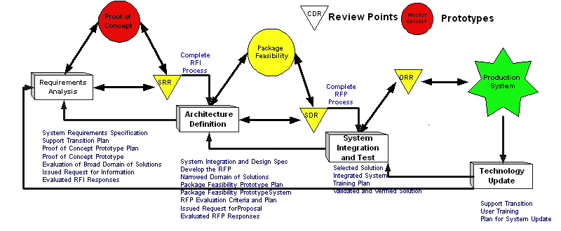
COTS Application Selection (1)

Slide 34
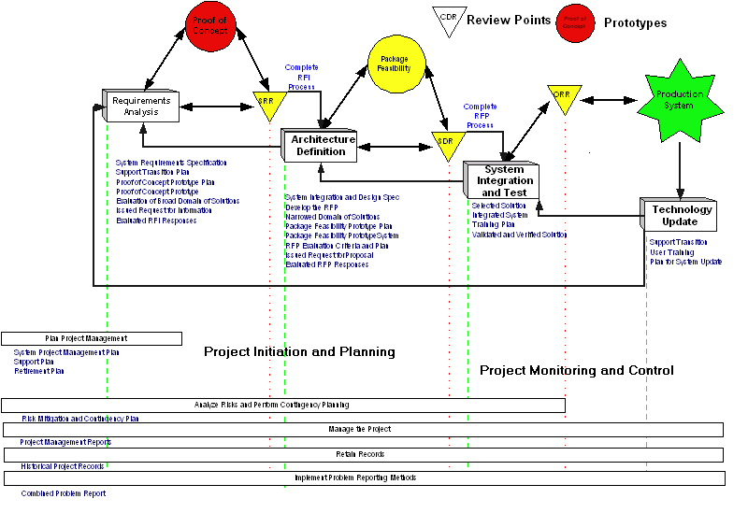
COTS Life Cycle (2)

Slide 35
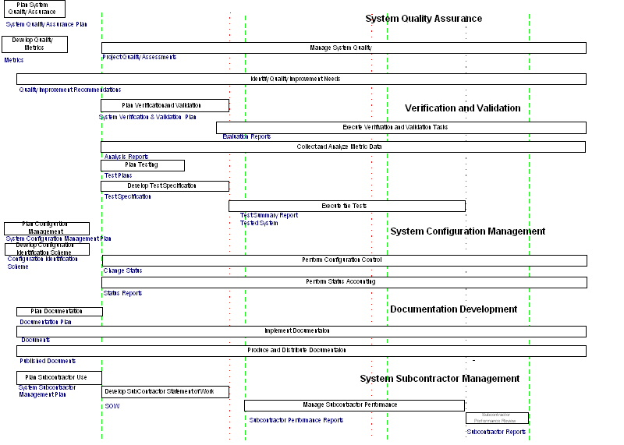
COTS Life Cycle (3)

Slide 36
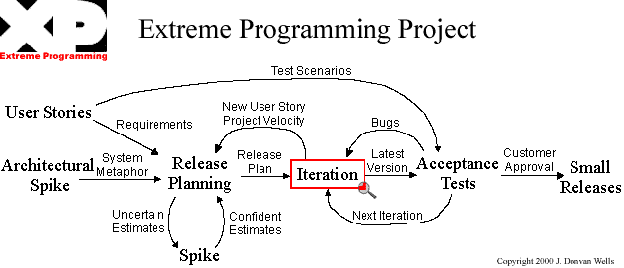
eXtreme Programming

Slide 37
eXtreme Programming - the propaganda
Light methods are adaptive rather than predictive. Heavy methods tend to try to plan out a large part of the software process in great detail for a long span of time, this works well until things change. So their nature is to resist change. The light methods, however, welcome change. They try to be processes that adapt and thrive on change, even to the point of changing themselves.
Light methods are people-oriented rather than process-oriented. They explicitly make a point of trying to work with peoples' nature rather than against them and to emphasize that software development should be an enjoyable activity.

Slide 38
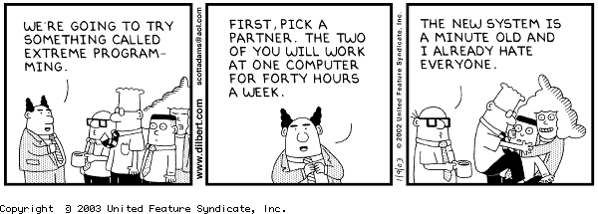
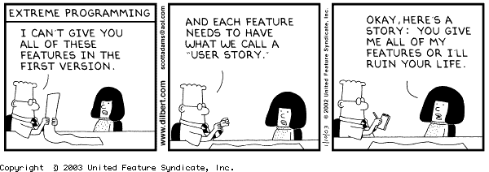
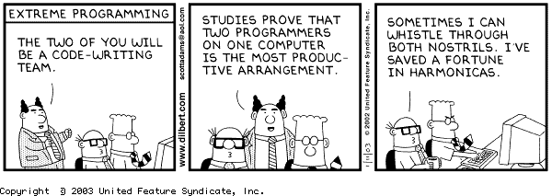
eXtreme Programming - the truth :-)

Slide 39
Classical “Best” Effort per Phase
5%
5%
30%
30%
20%
10%
Front end: 40 – 50%
Back end: 50 – 60%
100% of Product Full Life Cost

Slide 40
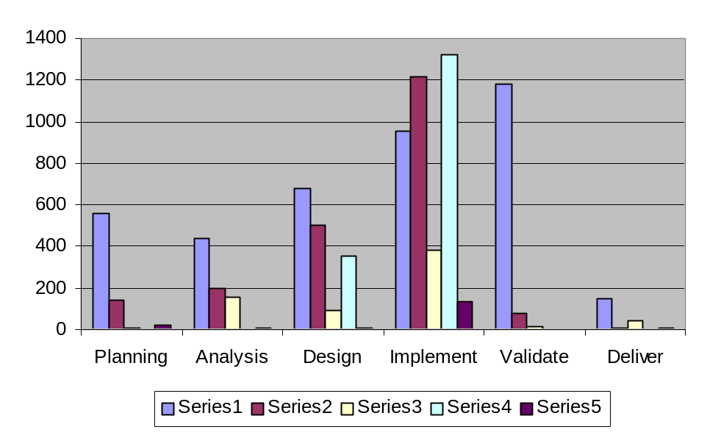
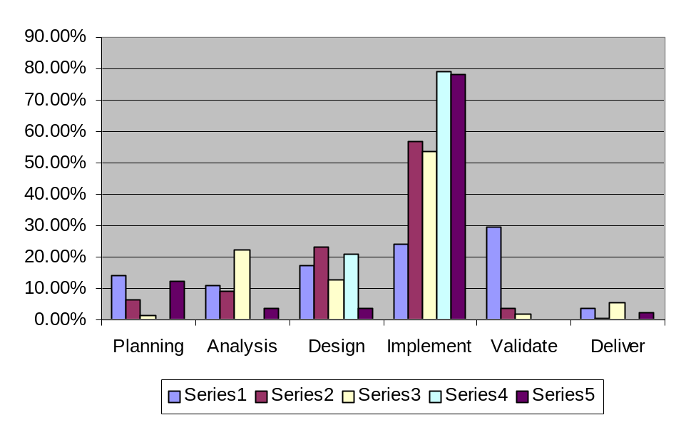
Real Web Project Metrics(1)
What is the message here?

Slide 41
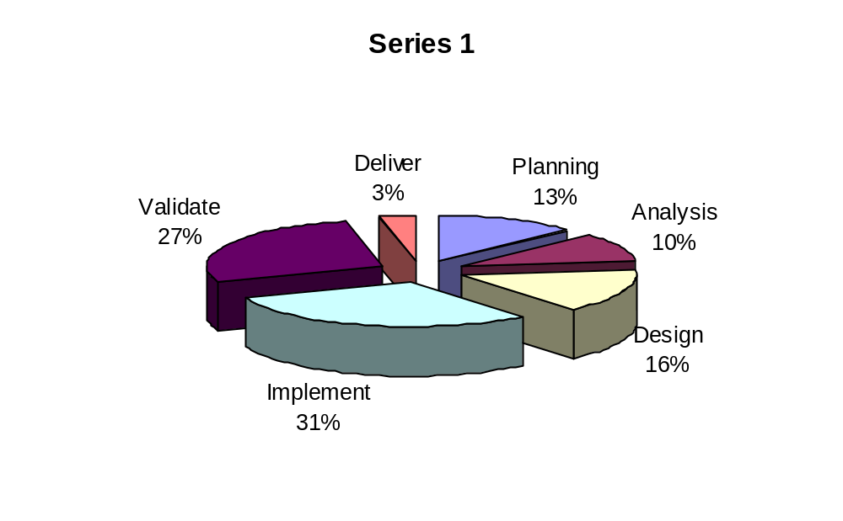
Real Web Project Metrics(2)

Slide 42
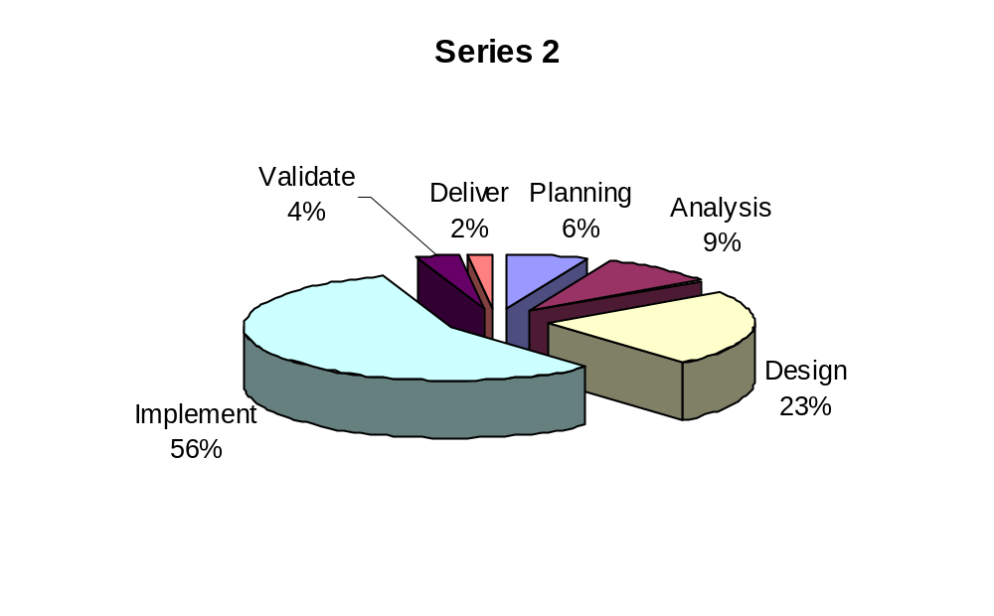
Real Web Project Metrics(3)

Slide 43
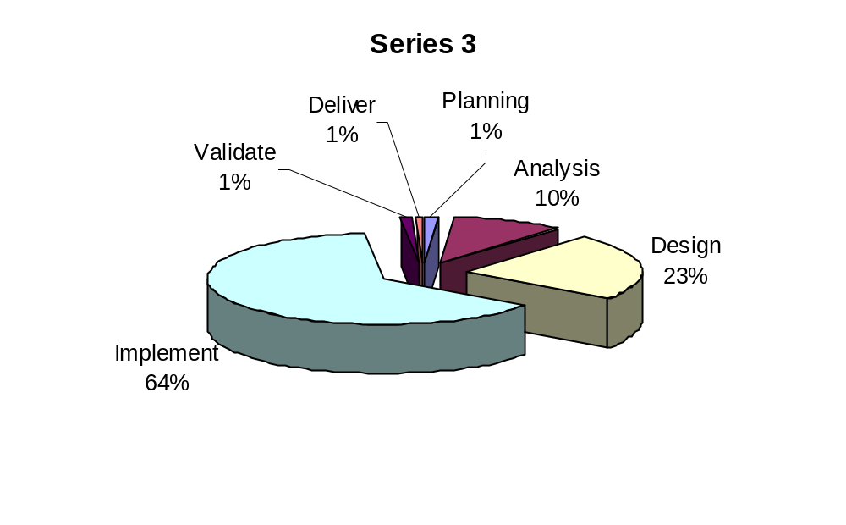
Real Web Project Metrics(4)

Slide 44
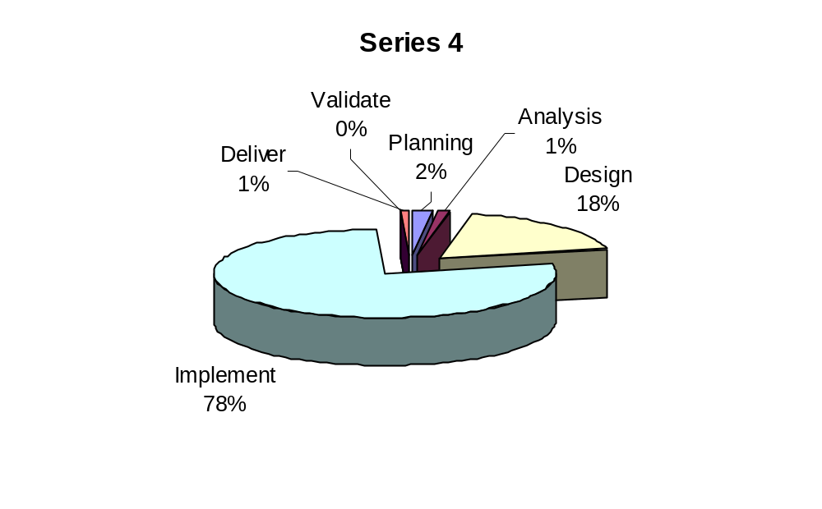
Real Web Project Metrics(5)

Slide 45
Web Effort per Phase (Preliminary Research)
7%
-3%
10%
-20%
16%
-14%
65%
+45%
2%
-8%
Front end: 40 – 50%
Back end: 50 – 60%
100% of Product Full Life Cost

Slide 46
Best Practices that Work
Define your life cycle
Set up a metrics system
Formalize project management
Develop a prototyping process
Institute reviews and inspections
Implement non-invasive configuration management
JAD with your customers

Slide 47
Defining Your Life Cycle Model
Become familiar with the various models
Review, analyze the type of work: development, enhancement, maintenance, etc.
Review project criteria
Identify a minimum set of phases
Identify phase activities
Establish a minimum set of deliverables
Define templates and content guides for deliverables
Evaluate progress and effectiveness of the life cycle framework
Implement improvements
Notes:
Models should be customized to meet the specific needs of the project for which they have been selected. The model should reflect the actual phases and activities expected to be performed on the project. This type of customization will assist in tracking the project to the model.
Major phases may be: Feasibility/Scoping, Planning, Analysis & Design, Execution, Delivery, Post Delivery
Another view is: Planning, Specification, Development, Post Project Analysis
Once the customization of the model is completed, the model becomes more meaningful to the project team and the user community. It can be used as a reference point during: status reporting sessions, demonstrations, risk assessment sessions, delivery of the final product.
What if during the course of the project, something changes which causes the team to think a different model may be more appropriate? Can the model be changed during the execution of the project? The answer is yes, it can be changed, but should be done with careful consideration to the impacts of the project. Ultimately, it is better to change the model than to attempt to use one that is ill-suited to meet the needs of the project.

Slide 48
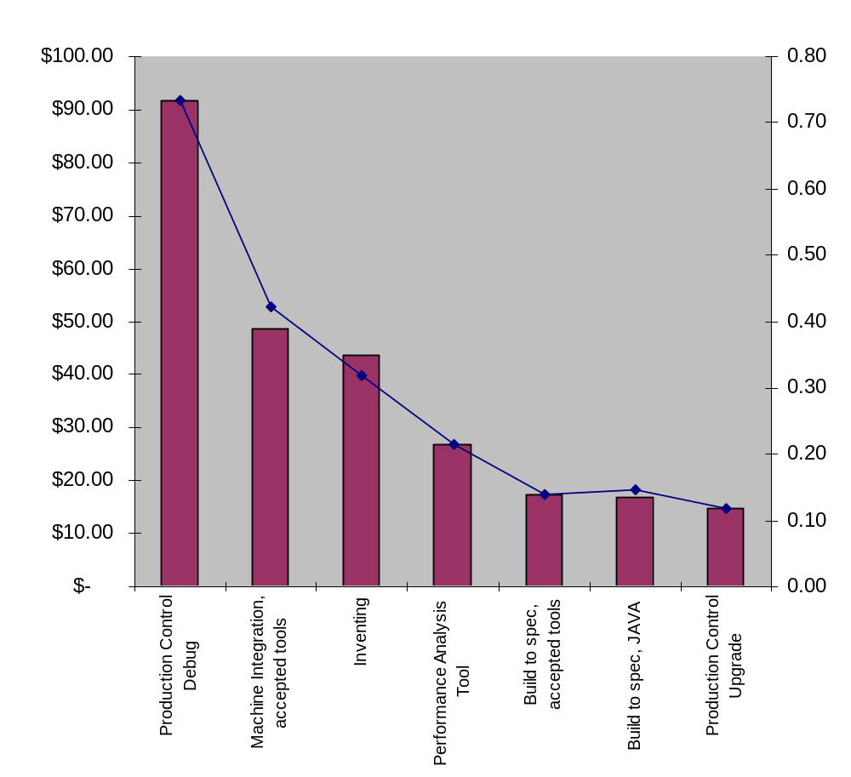
Why a metrics system?

Slide 49
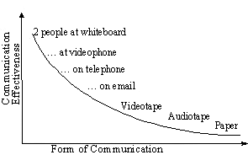
Best Practices that Work
Evolve to an object-oriented model
Embrace modeling with UML
Build early and often
Build anywhere
Communicate, communicate, communicate

Slide 50
Key Life Cycle Message
Whatever life cycle you start with will not be the one that will really work for you. You have to take charge of your life cycle, monitor it and adapt it to your circumstances. In the end it must become yours!

Slide 51

Are you secure with your process???
Questions ???

Slide 52
Linda Shafer Bio:
Linda Shafer has been working with the software industry since 1965, beginning with NASA in the early days of the space program. Her experience includes roles of programmer, designer, analyst, project leader, manager, and SQA/SQE. She has worked for large and small companies, including IBM, Control Data Corporation, Los Alamos National Laboratory, Computer Task Group, Sterling Information Group, and Motorola. She has also taught for and/or been in IT shops at The University of Houston, The University of Texas at Austin, The College of William and Mary, The Office of the Attorney General (Texas) and Motorola University. Ms. Shafer's publications include 25 refereed articles, and three books. She currently works for the Software Quality Institute and co-authored a SQI Software Engineering Series book published by PrenHall in 2002: Quality Software Project Management. She is on the International Press Committee of the IEEE and an author in the Software Engineering Series books for IEEE. Her MBA is from the University of New Mexico.

Slide 53
Don Shafer Bio:
Don Shafer is a co-founder, corporate director and Chief Technology Officer of Athens Group, Inc. Incorporated in June 1998, Athens Group is an employee-owned consulting firm, integrating technology strategy and software solutions. Prior to Athens Group, Shafer led groups developing and marketing hardware and software products for Motorola, AMD and Crystal Semiconductor. He was responsible for managing a $129 million-a-year PC product group that produced the award-winning audio components. From the development of low-level software drivers in yet-to-be-released Microsoft operating systems to the selection and monitoring of Taiwan semiconductor fabrication facilities, Shafer has led key product and process efforts. In the past three years he has led Athens engineers in developing industry standard semiconductor fab equipment software interfaces, definition of 300mm equipment integration tools, advanced process control state machine data collectors and embedded system control software agents. His latest patents are on joint work done with Agilent Technologies in state-based machine control. He earned a BS degree from the USAF Academy and an MBA from the University of Denver. Shafer’s work experience includes positions held at Boeing and Los Alamos National Laboratories. He is currently an adjunct professor in graduate software engineering at Southwest Texas His faculty web site is http://www.cs.swt.edu/~donshafer/. With two other colleagues in 2002, he wrote Quality Software Project Management for Prentice-Hall now used in both industry and academia. Currently he is working on an SCM book for the IEEE Software Engineering Series.

